Slide 1
Drug Mortality and Socio-Economic conditions in Connecticut
Sandhya Govindaraju, Monica James, Yayun (Aaron) Liu, Alisha Pandhi

Slide 2
Project Description
We were looking to analyze trends in drug overdose death rates in Connecticut by:
Income
Age
Education
Gender
Geo-location (counties)
Unemployment rates
Barriers to medical treatment
Drug

Slide 3
Struggles with data
We were not able to
Drug-induced mortality rates and income
Drug-induced mortality rates and education

Slide 4
Drug-induced mortality rates and age

Slide 5
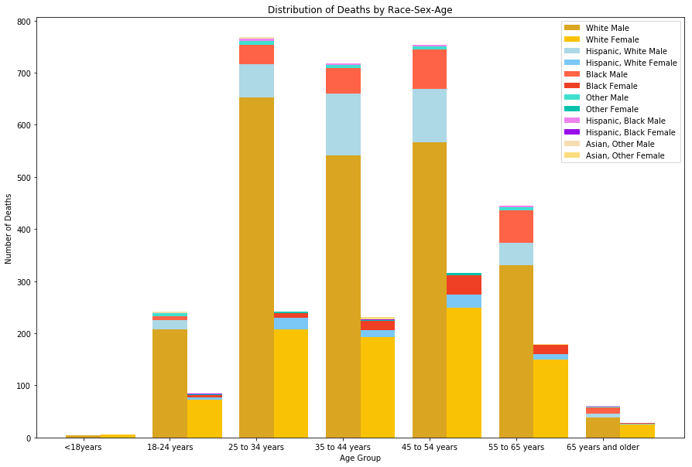
Drug-induced mortality rates and gender-race-age

Slide 6
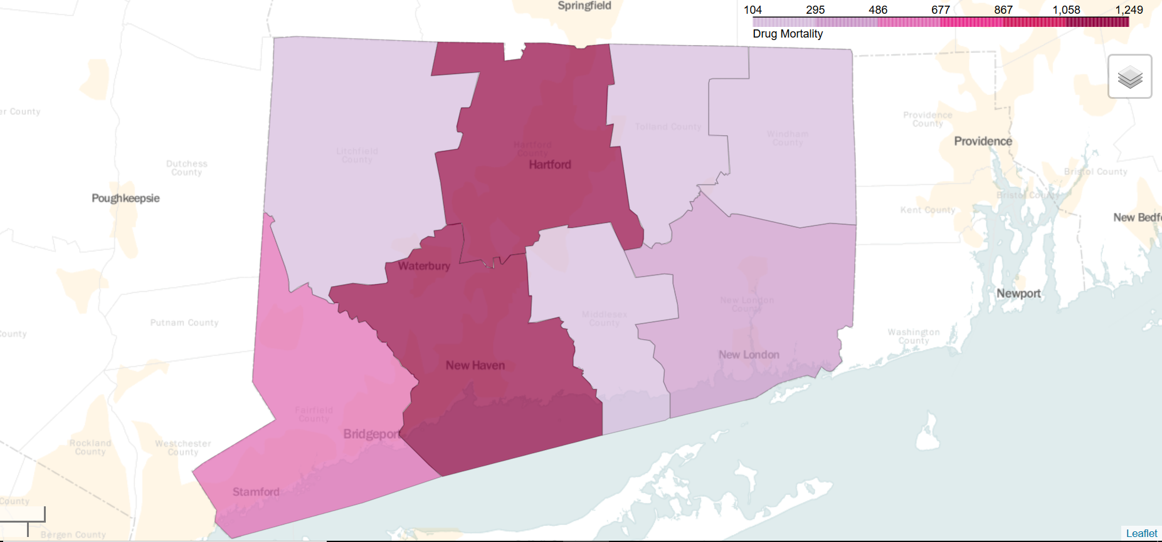
Drug-induced mortality rates counties

Slide 7
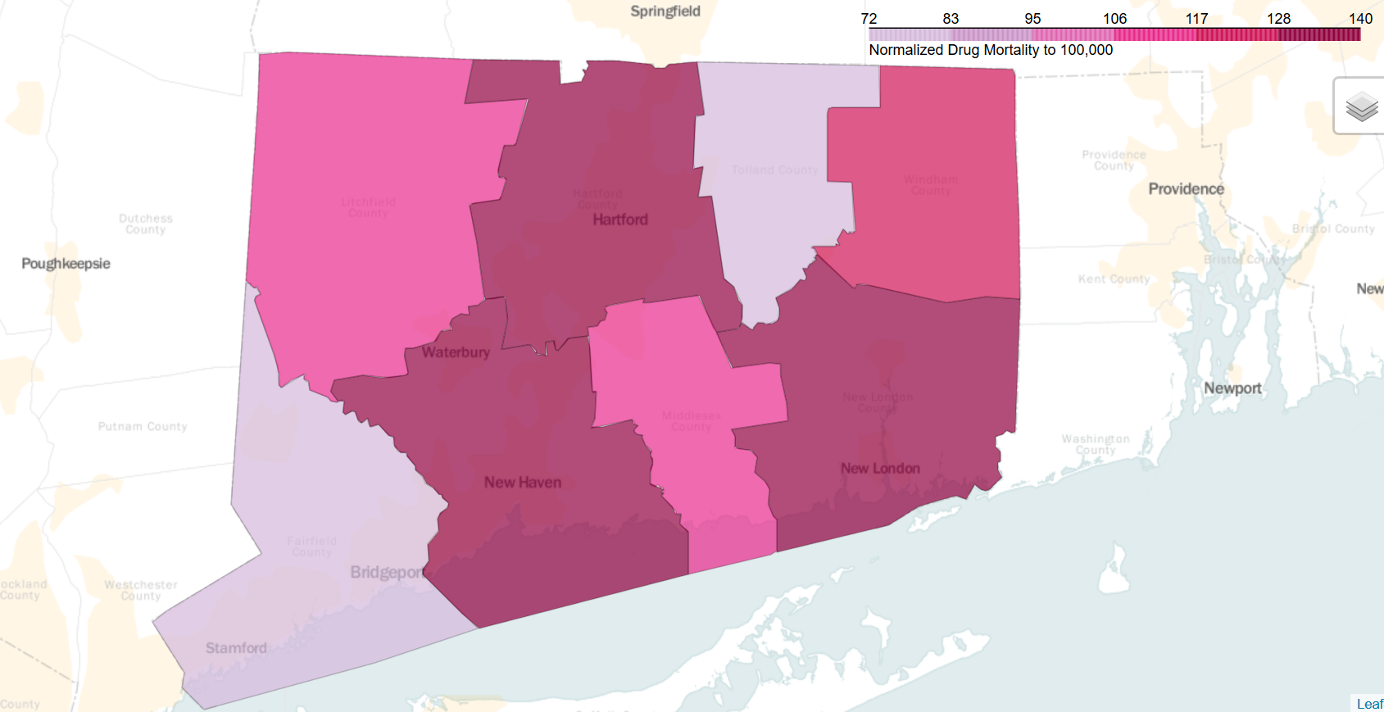
Drug-induced mortality rates and counties

Slide 8
Drug-induced mortality rates and unemployment rates

Slide 9
Drug-induced mortality rates and barriers to medical treatment

Slide 10
Drug-induced mortality rates by drug

Slide 11
Questions?

